Slide 1
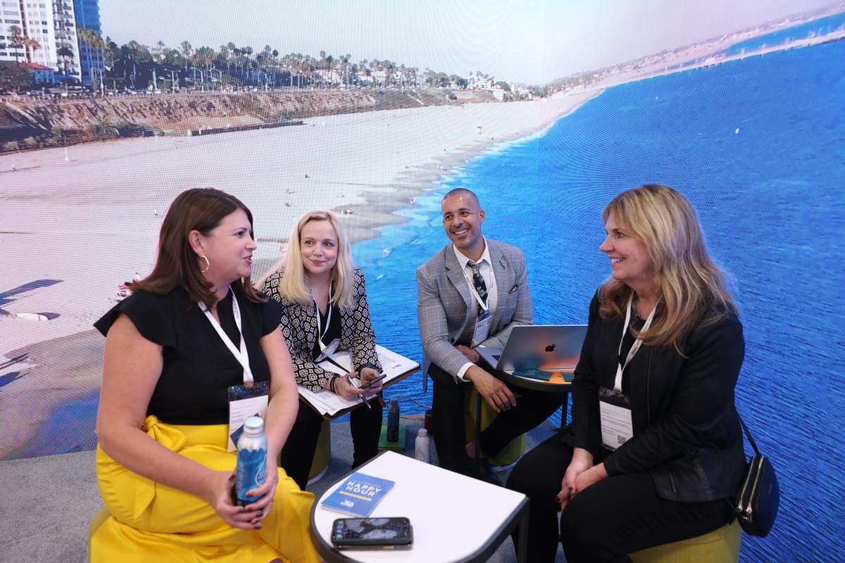
How to secure buyer meetings
Exhibitor Directory entry
Complete your company profile with description. Logo, images, video, brochures and social media links.
Ensure you also complete the products, services and operating location categories. Only choose the products, services and locations that your company offers. This helps buyers choose the right exhibitors to meet with when they use the Exhibitor Directory.
Your selections also make the Recommendations feature more accurate.
See our help guide
If you’re a booth coordinator you should make sure all your booth partners have also completed their company profile and products, services and operating location categories to give them maximum visibility in the Exhibitor Directory.

Slide 2
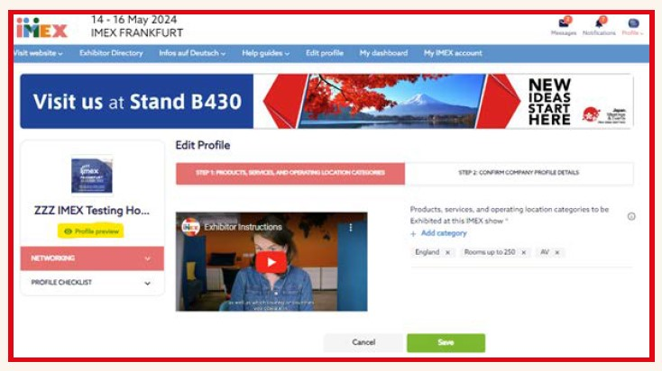
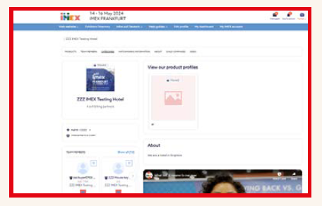
How to secure buyer meetings
Your company profile link
Need a shortcut link to promote your company’s participation on social media and to send to your clients?
Simply click on Profile Preview to copy and paste the URL.
This link will take buyers straight to your Exhibitor Directory page so they can easily book a meeting with you

Slide 3
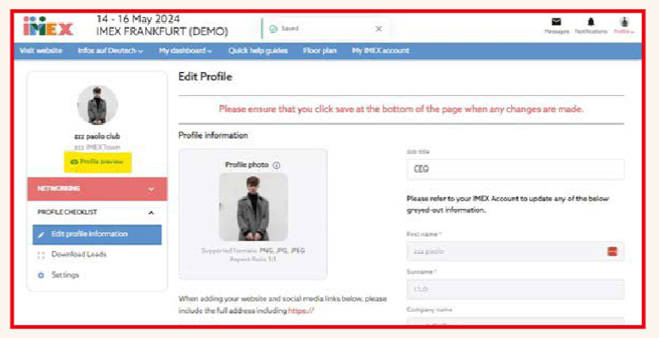
How to secure buyer meetings
Make it personal – maximize your individual profile
Our buyers are keen to meet you face to face so make sure you and all your team members have uploaded personal headshots to your individual profiles.
Make it personal. Tell the buyers a little bit about you; Do you have a fun fact you’d like to share? Do you want to stand out from the crowd? This is where you can do that.
Also add your job title and description of your responsibilities to help buyers select the right team member for the meeting.
See out help guide
Your individual profile link
Looking for a link to your individual profile to promote your participation on social media and send to your clients?
Simply click on Profile Preview to copy and paste the URL.

Slide 4
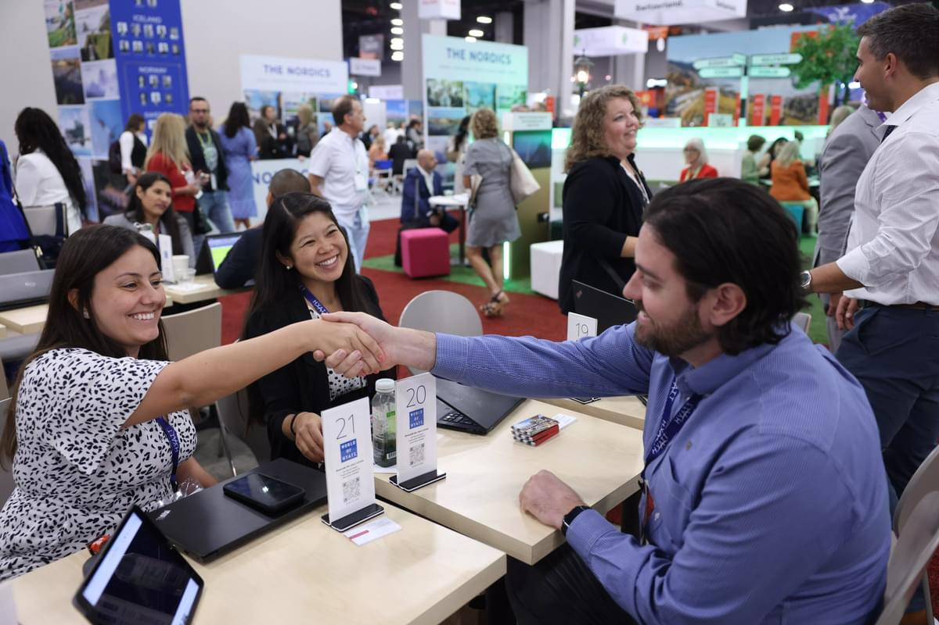
How to secure buyer meetings
Attendee List
The attendee list includes everyone coming to the show. You can search for buyers using a range of different filters including their names, company names or country.
You can also view and contact AI generated recommendations based on your compatibility with buyer profiles and actions in the show platform by using the Recommended for you option.
Messaging buyers
Once you’ve selected a buyer you want to meet at the show, you can send them an individual message.
You cannot send the same message to multiple buyers at once. This is by design. You can contact as many buyers as you like individually with personal and targeted messages.
Recommendations
Check your Recommendations. You’re far more likely to receive responses from buyers whose preferences match your products and services.
Favoriting
Check any alerts showing that a buyer has favorited your profile. These are good prospects as they’ve actively shown an interest in you.
You can favorite others by clicking the star icon in their profile.
You can use favoriting to build a bank of contacts to follow up with a message or to identify contacts you’d like to meet at the show.

Slide 5
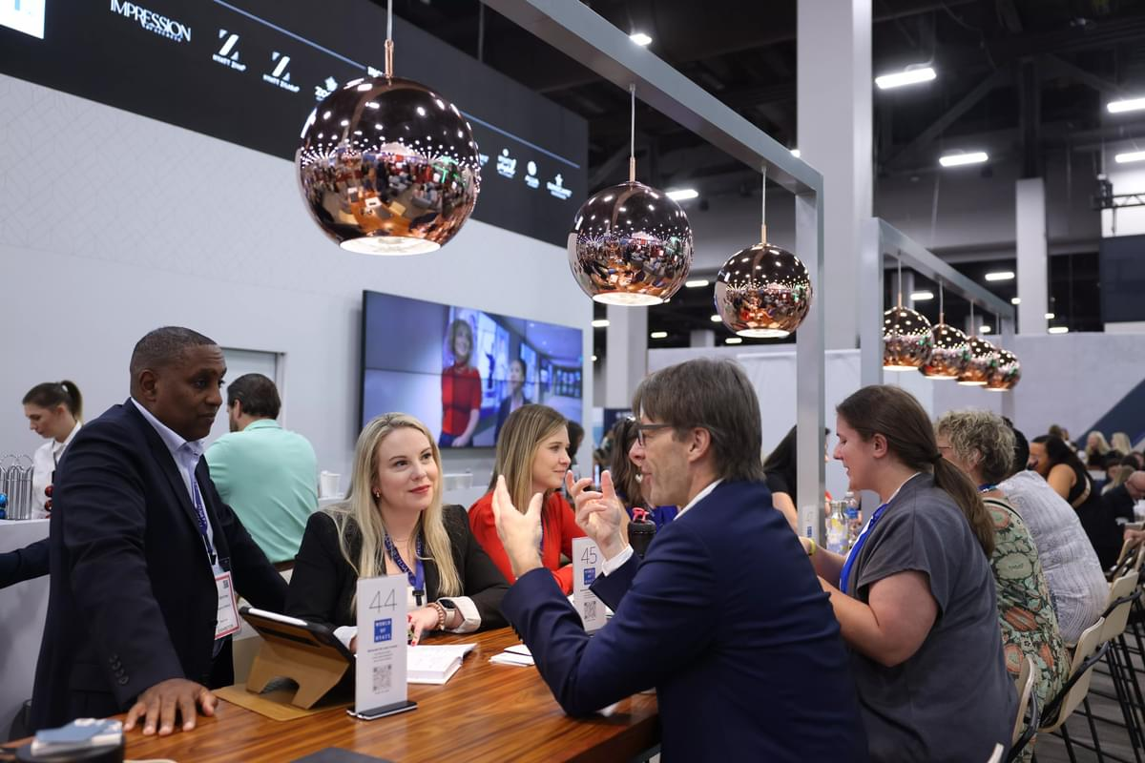
How to secure buyer meetings
Promotion beyond our show platform
Promote your attendance on LinkedIn and other social media.
Share a link to your Exhibitor Directory page in your email signature, on social media and by email to your clients
Include IMEX logos in your promotion. You can find them here
Share links to your booth activities/special at-show promotions on social media/by email
QR codes
Our show platform auto-generates QR codes for eachof your products and services, and for your individual and company profile. You can use these on your booth at the show.

Slide 6
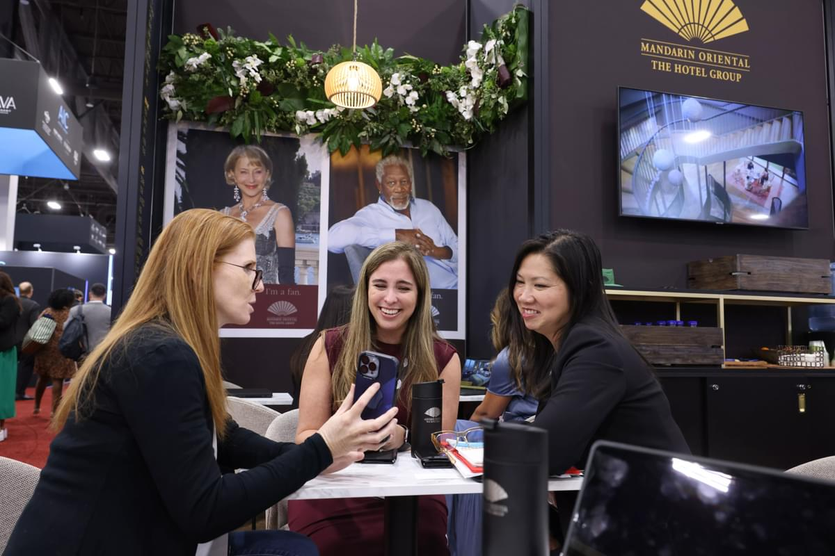
Preparing for meetings and following up
Prepare for your meetings in advance
Review your meetings carefully including any additional information that buyers may have uploaded for the meeting, such as RFPs. Look up buyers’ profiles on our show platform and on LinkedIn to help you make the most of your time during the meeting.
Leads dashboard
This gives an overview of all the buyers interacting with you. Keep track of buyers who favorite your company or individual profile, products and services. You can message them direct, encouraging them to book a meeting with you.
Lead scanning at the show
Lead scanning is free for all exhibitors on the IMEX app
Download the IMEX app and familiarize your team members with it before the show. Practice scanning badges, messaging and managing your schedules. (We will email you when the app is available for download)
At the show, make sure all your team members and partners use the lead scanning tool in the app.
All at show and online leads appear in your leads downloads making follow-ups easier.

